Slide 1

January 2023
Stata workshop
Statistical Software in Public Policy Workshop Series
Alfonso Rojas-Álvarez, Ph.D.
LBJ School of Public Affairs, The University of Texas at Austin

Slide 2
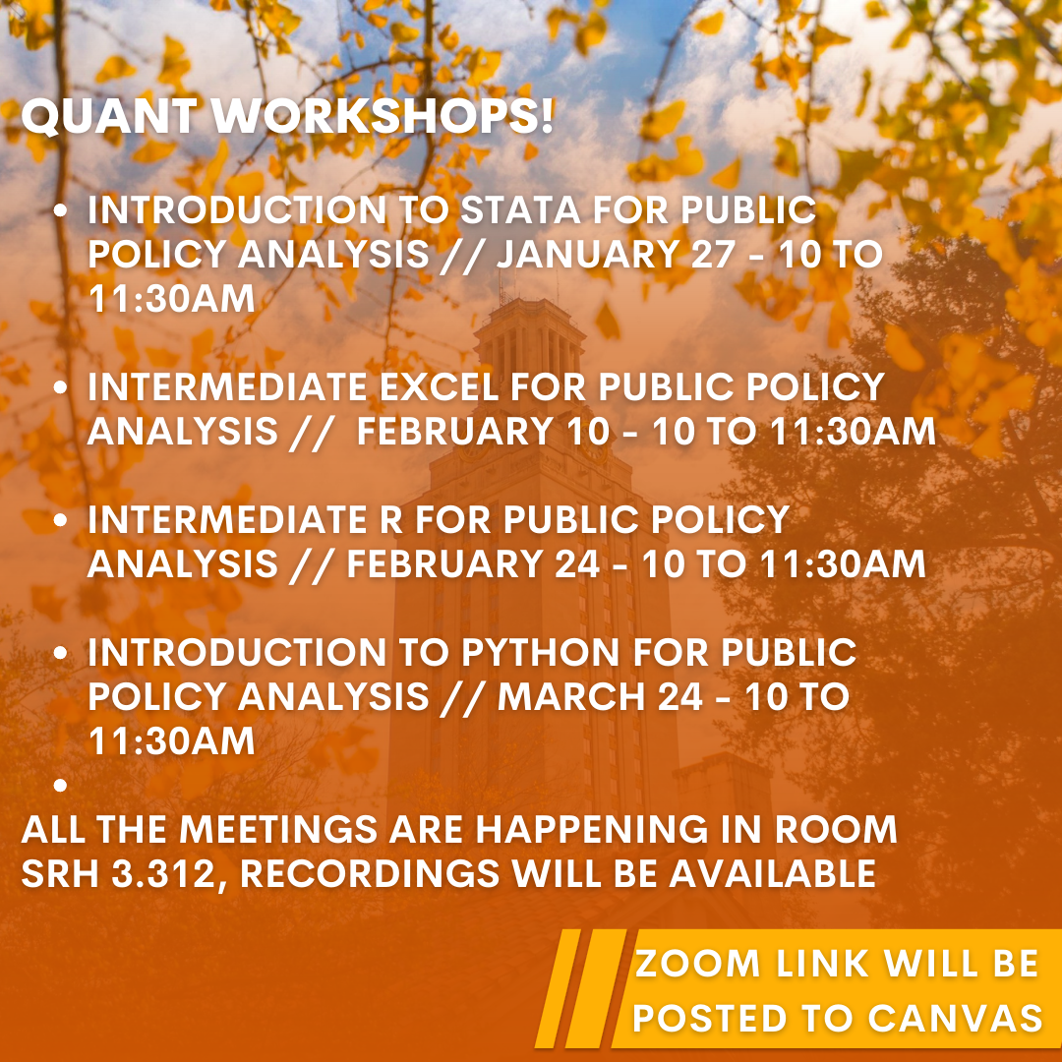
Welcome!
First of four statistical software workshops in the Fall
Contact: arojas@austin.utexas.edu
(512-552-9860)
Say the class/subject upfront!

Slide 3
About these workshops
Workshops are à la carte; come to any you choose based on your needs.
There is no evaluation, evaluation or required participation.
We won’t be going over installation of the software.
1 hour of lecture and 10-15 minutes of Q&A and troubleshooting
Feel free to ask questions whenever!
Office Hours for technical, software or installation assistance (or anything else):
Monday 10-11:30am; Thursday 2-3:30pm, in SRH 3.264.

Slide 4
Introduction to Stata in Public Policy
Contents for today’s workshop:
What is Stata
First steps on using Stata – sample data set
Basic exploratory and cleaning commands
EDA and combining
Scripting (do-files)
Advanced applications (regression, panel data)
Q&A
Contents at: https://github.com/LBJ-SoftwareWorkshops

Slide 5
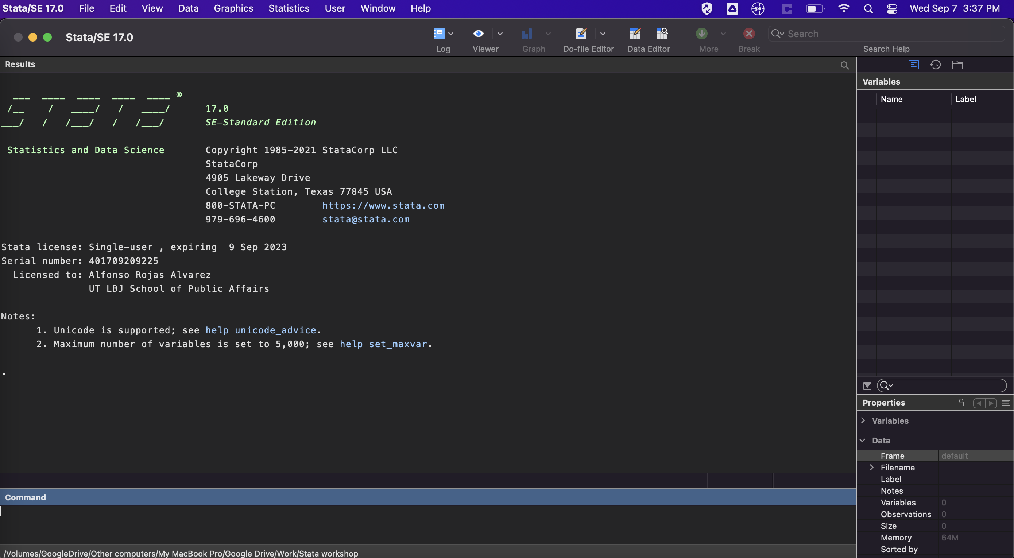
What is Stata?
Statistical software package for datasets:
Explore,
Summarize
Analyze
Predominant:
Social sciences
Economics
Public policy
Available:
LBJ School labs
CNS Stats Server

Slide 6
Initial setup
Set your working directory
Create a do-file
“Code or no-code” --> choose your own adventure
Open a dataset (.dta or import excel, csv and others)
Sample dataset for today: sysuse census.dta
Edit data (careful!)
Color coding and variable types
Save your data
More advanced tasks:
Create a log
Memory allocation
Demo!

Slide 7
Basic exploratory and cleaning commands
Exploring:
describe, summarize, tab, table, crosstabs, tabstats
“if” commands
Cleaning:
rename, label, gen
egen, sort, create id’s by group
drop, keep
Options for each command:
Use help!
Use Stackoverflow!
Demo!

Slide 8
Exploratory Data Analysis and Combining
Plots
Scatterplots
Histograms
Boxplots
Density plots
Titles, legends, axis, and others.
Combining datasets
Why do we want to combine?
Append or merge?
Link variable for merging
Common frames for appending
One to one, many to one, many to many
Demo!

Slide 9
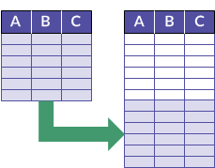
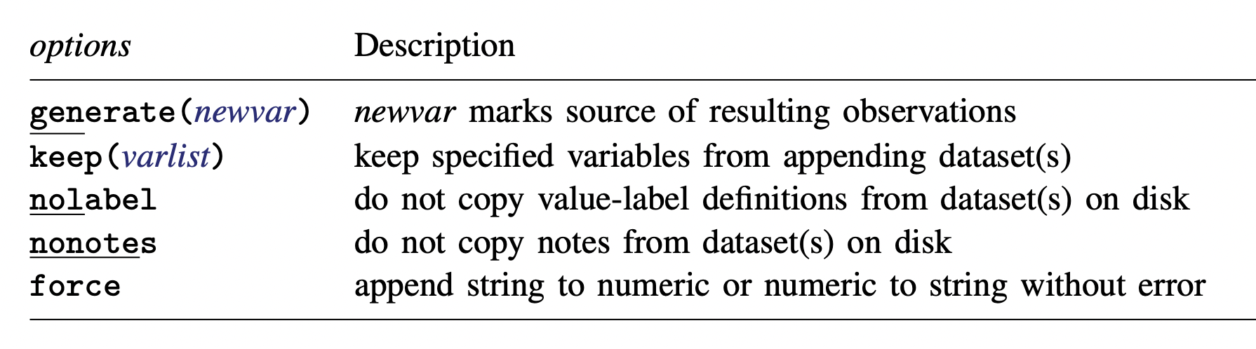
Append
You’re adding rows to an existing frame
Open dataset X, have Y in same directory
You need the variables to match
append using y
Y
X
Image Credit: HighBond

Slide 10
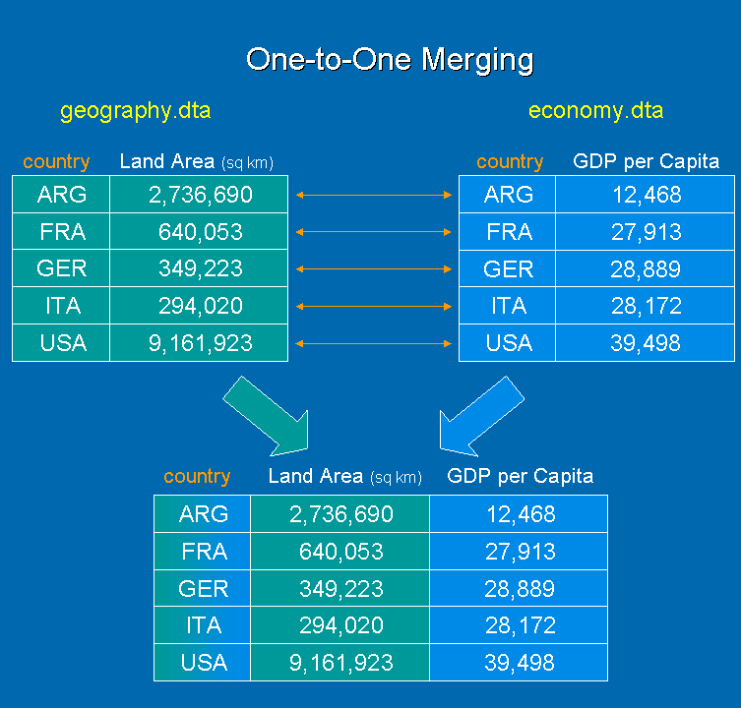
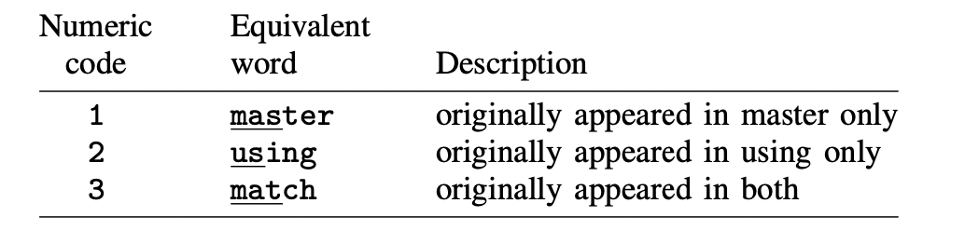
Merge
You’re adding columns using a link variable
Open dataset X, have Y in same directory, sort
Variables don’t have to match
Rows can (and should) match but don’t have to
_merge variable provides key information:
merge country using economy.dta
Y
X
Image Credit: StataProject Blog

Slide 11
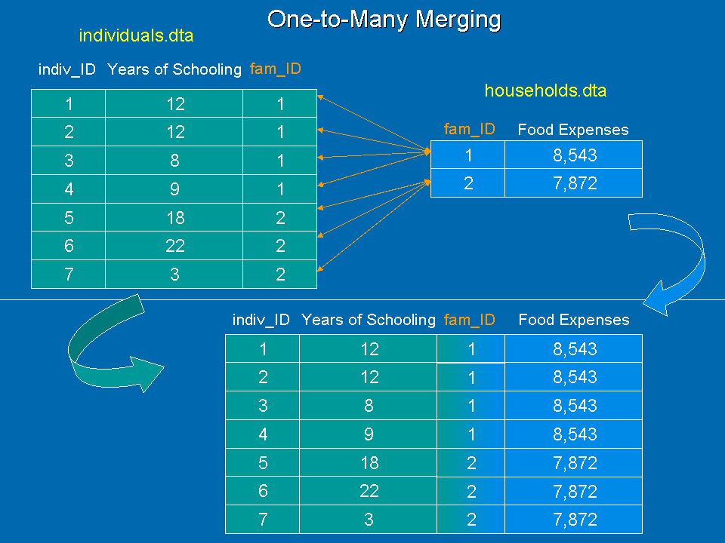
One-to-Many Merge
Several observations per identifier
Open dataset X, have Y in same directory, sort
Variables don’t have to match
Be very careful! Validate before saving
Many-to-one also works!
Avoid many-to-many if possible
merge 1:m fam_id using individuals.dta
Y
X
Image Credit: StataProject Blog

Slide 12
Scripting in Stata
The power of do-files
Replicability and version control
Sharing and exchanging scripts (code)
Time saving

Slide 13
Advanced applications
Regression
Panel data (fe and re)
Classification (logistic and glm)
Estimation (error estimation and others)
Demo!

Slide 14
Q&A
Office Hours for technical, software or installation assistance (or anything else):
Monday 10-11:30am; Thursday 1-2:30pm, in SRH 3.264.
Contact: arojas@austin.utexas.edu | (512-552-9860)
Say the class/subject upfront!

